Slide 1




HALF OF ALL SATELLITE OBSERVATIONS FAIL!🛰️
Imagine: You set up all your equipment...
...and HALF the time, nothing happens
CURRENT: 49.5% success rate
🎯 MY GOAL: Make it MUCH better!
Shadi Shadabshoar
Capstone Project
Dec 2025
Notes:
Research Results entry doc

Slide 2




Event Overview
🌍 SatNOGs: Earth's Biggest Satellite Fan Club!
📡 600+ volunteers worldwide
🛰️ 12.5 MILLION observations
🤝 All open-source & free
Think: Wikipedia + NASA + Your Neighbor's Backyard
Notes:
Please, replace the image with a more suitable. Avoid removing the blue shape!

Slide 3

📊 My Data Treasure Hunt
Started with: Messy CSV files 😫 but found: 22GB SQL Database! 🎉
💎 My Treasure: 578,000 clean observations
⏰ Time: 2021-2025
📍 Location: Global!

Slide 4




⚠️ THE "OH NO" MOMENT!
My First AI Model: 100% Accurate! 🤖 Me: "I'm a genius!" Reality: Data was CHEATING! 😅
The Culprit: One column predicted everything!
Fix: Remove it → Real results: 56.9%
Lesson: AI isn't magic! Always check for data leakage!

Slide 5

BUILDING THE PREDICTOR
Next Steps:
Communicating Results
Contestants:
1. Logistic Regression: 56.9%
2. Decision Tree: 69.6% 🌳
3. Random Forest: 82.7% 🌲🌲🌲
4. XGBoost: 85.0% 🚀
Winner: Random Forest! 🏆
Notes:
Please, replace the image with a more suitable. Avoid removing the blue shape!

Slide 6
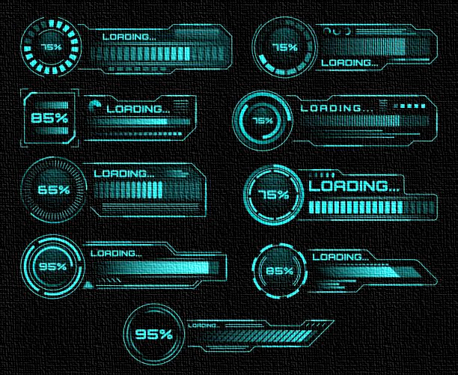

DRUMROLL PLEASE...
🚀 SUCCESS RATE: 49.5% → 88.3%
📉 FAILED OBS: Down 76.8%
🎯 ACCURACY: 94.6%
For every 100 observations:
Before: ~50 worked ✅
After: ~88 work! ✅✅✅
That's ALMOST DOUBLE! ✨
Notes:
Please, replace the image with a more suitable. Avoid removing the blue shape!

Slide 7
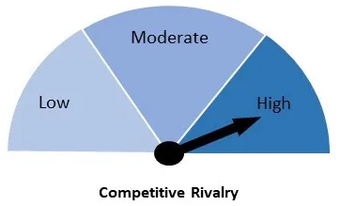

🔍 Surprising Discoveries:
🥇 #1 Factor: Archived Status
→ Archived = 19.4% better success!
🥈 #2 Factor: Year
→ Recent = Better results
🥉 #3 Factor: Location
→ Sweet spot: 40.2°-52.7° latitude
Good cleaning helps! 🧹

Slide 8

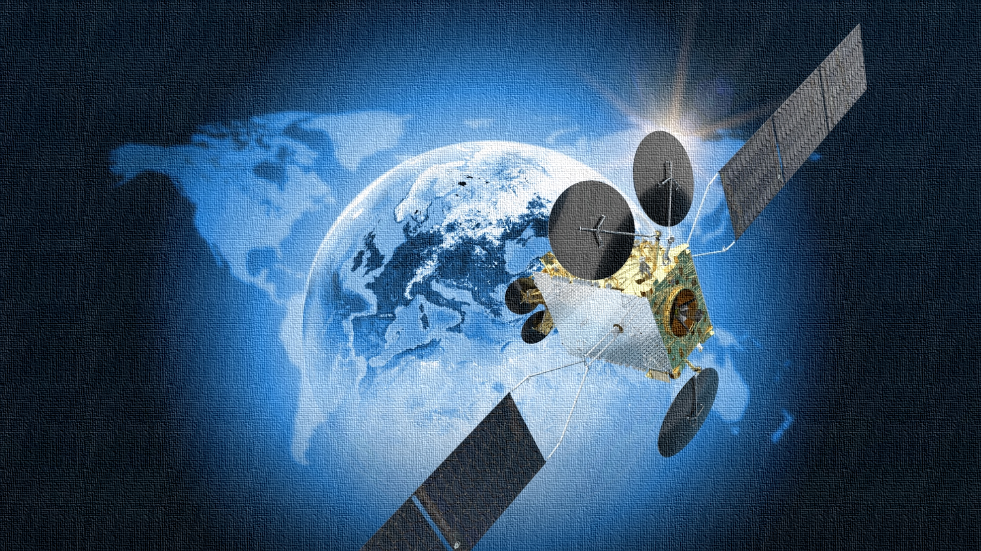
🎮 Game Rules for Satellite Operators:
Rule 1️⃣: Archived + Recent = HIGH Priority
Rule 2️⃣: Pick stations in "Goldilocks Zone" 🌍
Rule 3️⃣: If >90% confidence → GO FOR IT!
Rule 4️⃣: Schedule during daytime ☀️
Simple rules, BIG impact! 💥

Slide 9
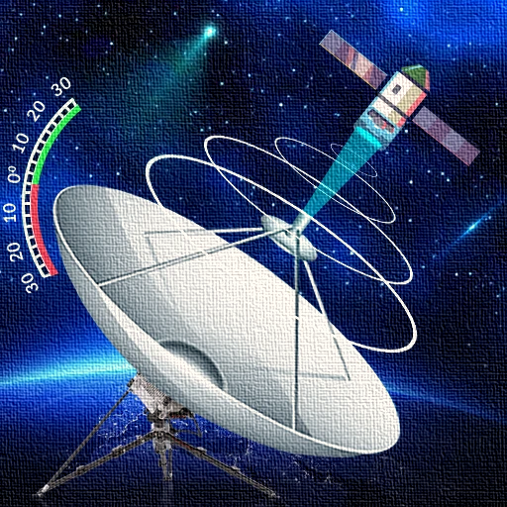
THE FUTURE IS BRIGHT!
🚀 What's Next?
🎯 Phase 1: Add to SatNOGS scheduler
🌤️ Phase 2: Add weather data
📱 Phase 3: Mobile app
🌐 Phase 4: Global optimization
AI isn't about fancy math... It's about helping REAL people! 🤝

Slide 10

“
“Machine learning isn’t just about accuracy; it’s about measurable real-world impact.”
Thank You!

